Slide 1

B.Tech Project Evaluation, VIIIth Sem
Project Title- COUNTERFEIT PROTECTION IN SUPPLY CHAIN USING
BLOCKCHAIN
Presented by :
Mohammad Adnan Muzafar (2019001743)
Aman Bhargava (2019601326)
Anupriya Jha (2019573254)
Under the Supervision of:-
Dr. (Prof.) Parma Nand Astya (Dean - SET & Academics)
DEPARTMENT OF COMPUTER SCIENCE & ENGINEERING
SHARDA SCHOOL OF ENGINEERING AND TECHNOLOGY
2023
‹#›

Slide 2



CONTENTS OF THE PRESENTATION
Introduction to the project
Problem Statements/Objectives of the Project
Workload distribution/ Team Work
Methodology used
Solution Approach
Algorithms and framework
Outcome Produced
Proof of the Outcome

Slide 3
INTRODUCTION TO THE PROJECT
Any product may be tracked back to its sources with the use of a hyperledger blockchain-based solution that handles tracking and tracing of items in the supply chain.
The issue of counterfeiting can be effectively addressed by constructing a tracking system. Because of the inherent immutability and consistency of recorded data maintained by encryption and permission processes, blockchain is highly suited for developing product tracking systems.
We suggest developing a tracking system that will integrate all suppliers—manufacturers, wholesalers, distributors, and retail establishments—into a single location. Contact this chain on a commercial basis to provide accurate product monitoring without upsetting the supply chain.
We propose a solution that may secure the supply chain, lessen the likelihood of counterfeit products surfacing, boost the reputation of the brand, and directly support the cause.

Slide 4
PROBLEM STATEMENTS/OBJECTIVES OF THE PROJECT
The aim/objectives of this project are:
AIM: development of application.
The aim of the project is to develop a blockchain based counterfeit protection system for supply chain.
Objectives:
Proposal for a solution -
To develop a Hyperledger based solution consisting of a shared, permanent, and permissioned record of supply data in which the participants can be connected across the entire supply chain for tackling the problem of counterfeits.
Additional services –
Increased traceability, trackability and security for the supply chain.
Research-
To further research about the implementation of blockchain in the area of ownership rights.

Slide 5
METHODOLOGY
Due to incomplete information transparency and a lack of interoperability in traditional supply chain models, reports are frequently erroneous. Given how difficult it is to trace items along the whole supply chain, emails and printed documents can only carry a limited amount of visibility and traceability information. The real worth of the goods a buyer purchases is essentially hard to determine. A game-changing alternative for conventional supply chain companies, the blockchain is a transparent, immutable, and secure decentralized system.
The following areas may be improved in order to assist create a successful supply chain system:
1. Monitoring all the items throughout the supply chain.
2. Confirming and validating the chain's items.
3. Information exchanged between supply chain participants about the whole network.
4. Enhanced auditability is provided.
The components that are being developed are done using solidity with the network - hyperledger fabric, middleware apis using node, docker and node.Js for SDK. Figure below shows the flow and the players present in the supply chain that may use the system.

Slide 6
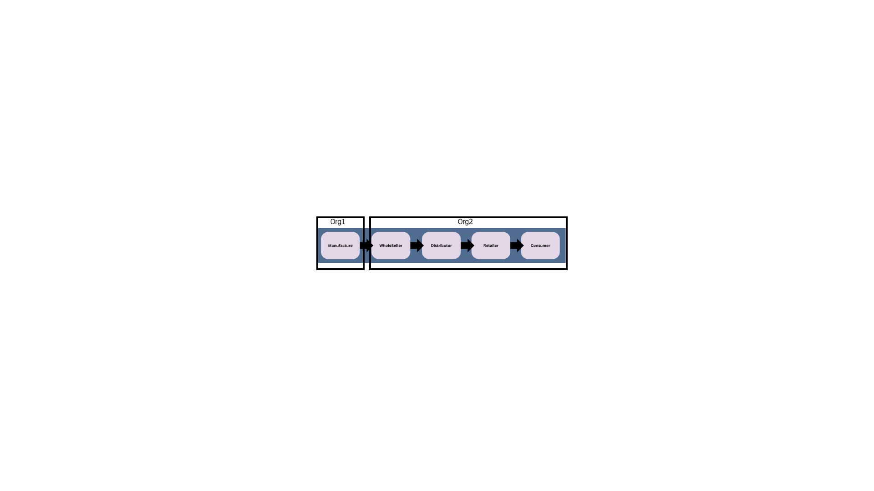
SOLUTION APPROACH
The proposed solution is for a straightforward supply chain network that complies with business needs. For this reason, two organizations are maintained which are; org1, referring to the manufacturer (one end point), and org2, referring to all the possible end nodes (points) in the supply chain like wholesalers, distributors, and retailer.
Data flow begins at the manufacturer where the original goods are generated and ends when the finished goods are purchased in retail establishments mapped in the chain.
Figure 1 depicts the structure of the two organizations within the chain.
Figure: Structure of the two organization within the supply chain.

Slide 7
CONT…
With respect to the above proposed system, following operations have developed centered around the products that will move across the supply chain.
The table below describes these operations.
Operation | Input | Output
Create | UID | None
Get | UID | Product Information
ShipTo | UID and the next node address | None
GetHistory | UID | Product Supply Chain History

Slide 8
ALGORITHMS AND FRAMEWORK
Application flow
The application flow of the system in order is given as follows:
An admin enrolls users into the application.
Only the manufacturer will be able to develop new products.
Product will then be delivered to wholeseller.
The items will be delivered by wholesalers to the distributor.
Retailer will get it from the distributor.
Orders might be placed by customers.
Once the goods are delivered, the customer will mark it as delivered.

Slide 9
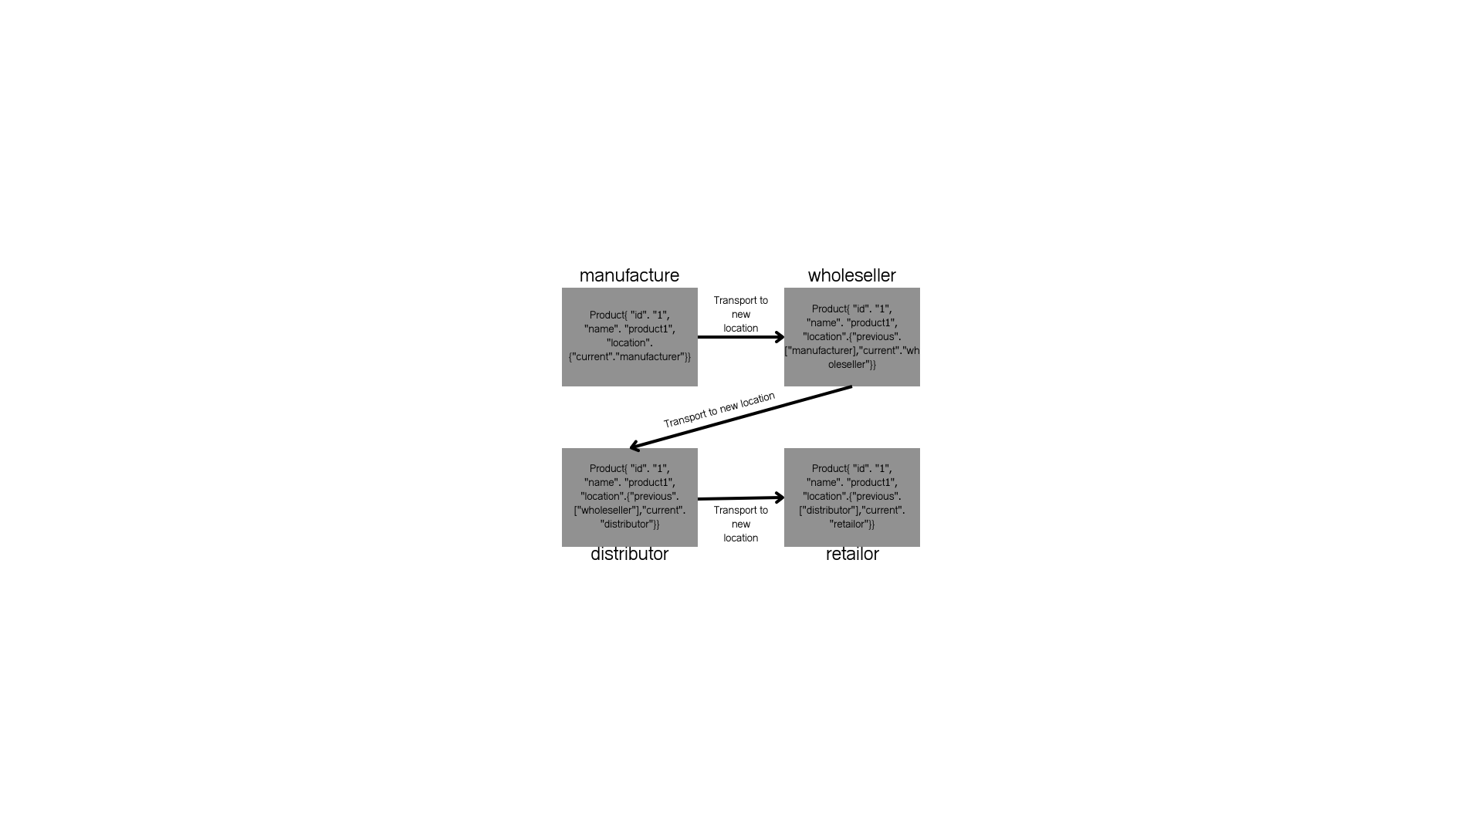
CONT…
Figure shows the flow of data for a product “product1” with id “1” in nodes from manufacturer to the retailer.
Figure: Data Flow Diagram

Slide 10
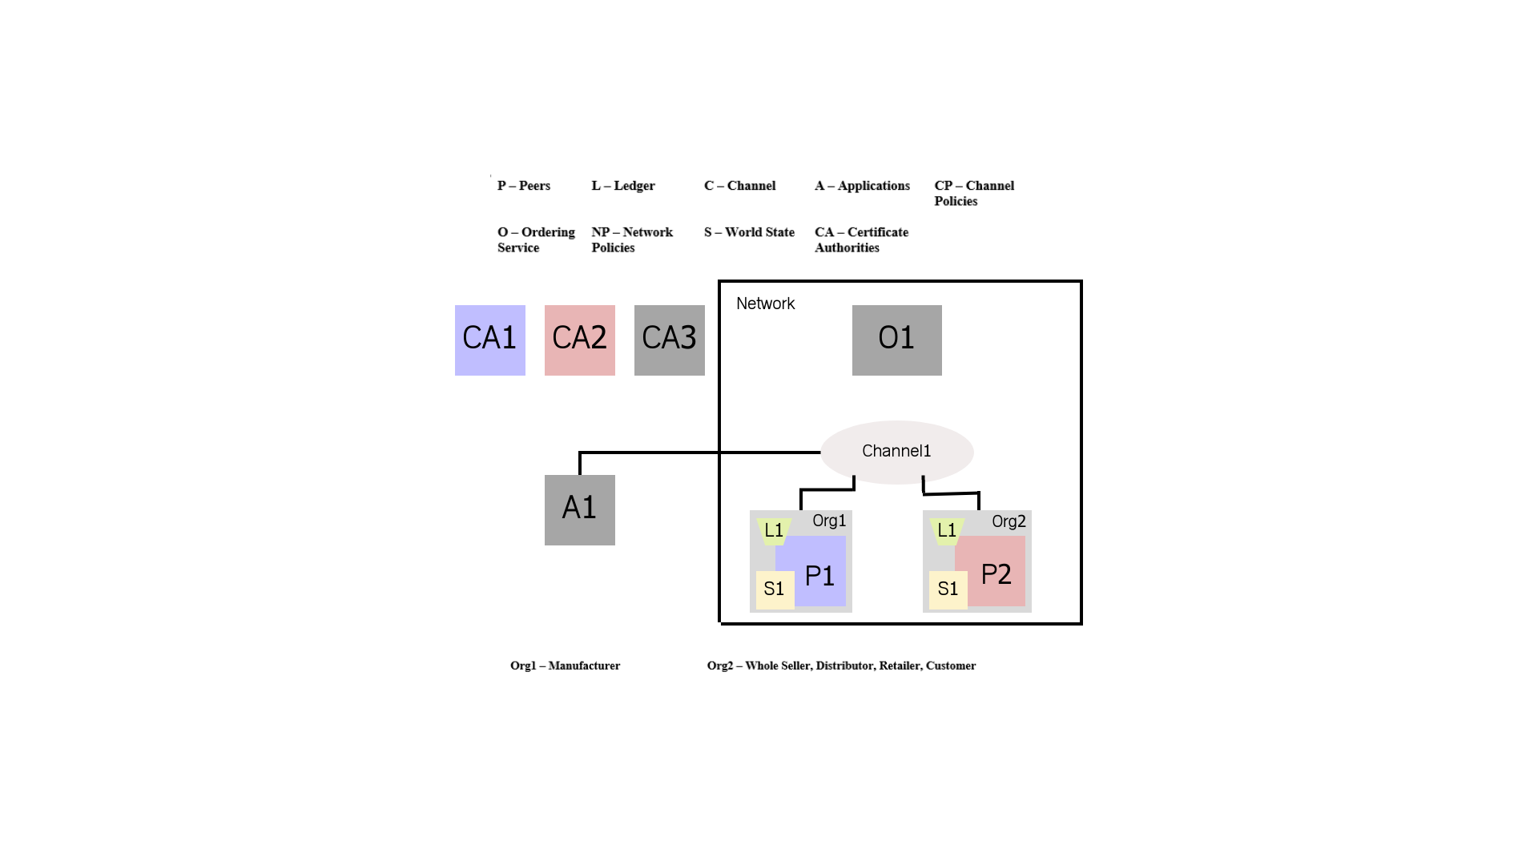
CONT…
SYSTEM ARCHITECTURE
Each organization will have a peer node of their own, and to add the transactions to the ledger, an orderer (O) node will be linked to the same channel as the peer nodes. The interface of the various companies each have their own user certificates that are created by the fabric-ca binaries and used to sign transactions. The figure describes the overall architecture of the system.
Figure 3.4.1: System Architecture

Slide 11
CONT…
According to the hierarchy, peer nodes' user roles limit access to chaincode functionality. The result is that a manager job will have full access to all functions while an Employee role will only have limited view access.
Data begins to flow from the producer or supplier, and at each level of the transaction, more information about the product is added and saved.
The seller and the supplier are the only two entities that are currently included in the system's scope. The network is used to log the exchanges between the two businesses in each one's own ledger.

Slide 12
CONT…
Architecture Flow
A Docker Kubernetes Service is created by the blockchain operator.
On a Docker Kubernetes Service, users build a Hyperledger Fabric network, and the network operator instals and instantiates the smart contract.
The Fabric SDK is used by the Node.js application server to communicate with the deployed network on the local or cloud platform where Hyperledger is running.
The Node.js application API is used by the React UI to communicate and send network transactions.
To update and query the blockchain ledger and state, the user interacts with the supply chain application's web interface.

Slide 13
OUTCOME PRODUCED
Proposed model output:
The project has been developed. We have been able to achieve the goal of this project by drafting 2 research papers; “Counterfeit Protection in Supply chain Using Blockchain: A Review”, and “Securing the supply chain: A Comprehensive Solution with Blockchain Technology and QR- Based Anti-Counterfeit Mechanism”.
On development side we have successfully developed a working backend Application and have exposed the Rest API’s for the Hyperledger Based Blockchain Solution for tracking and tracing the supply chain to reduce counterfeiting, Some Snippets from the modules that have been developed are shown in the following slides.

Slide 14
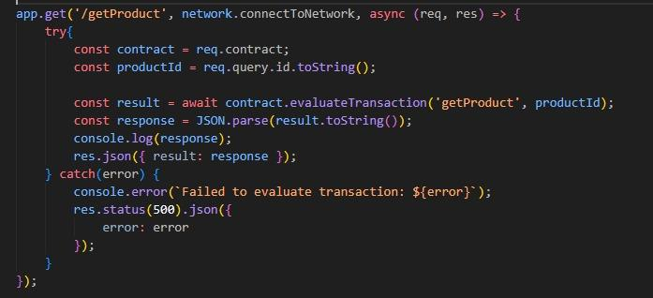
CONT…
GET PRODUCT API:
Retrieves information about the product over the local host.
The API code is given in the figure.

Slide 15
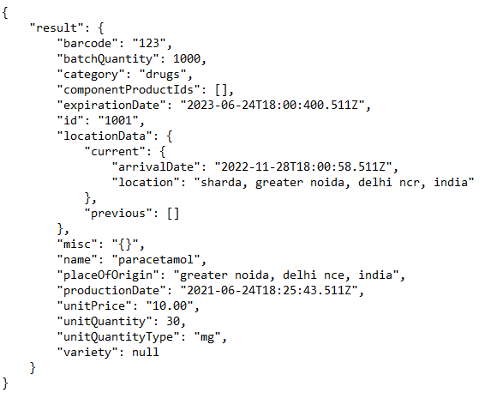
CONT…
GET PRODUCT API:
The output of the above given API snippet is given in the figure.

Slide 16
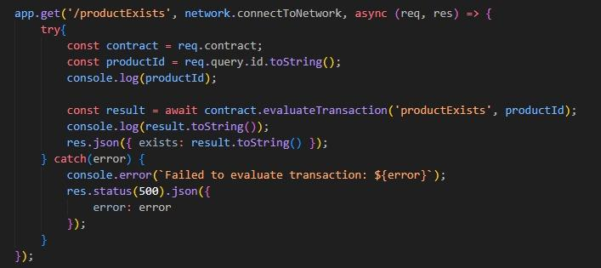
CONT…
PRODUCT EXISTS API:
Verifies if a product exists or not over the local host.
The API code is given in the figure.

Slide 17
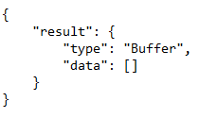
CONT…
PRODUCT EXISTS API:
The output of the above given API snippet is given in the figure.

Slide 18
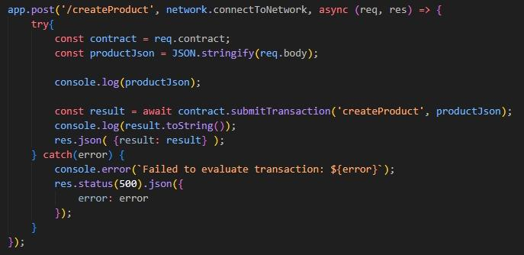
CONT…
CREATE PRODUCT API:
Creates a new product, over the local host.
The API code is given in the figure.

Slide 19

CONT…
CREATE PRODUCT API:
The output of the above given API snippet is given in the figure.

Slide 20
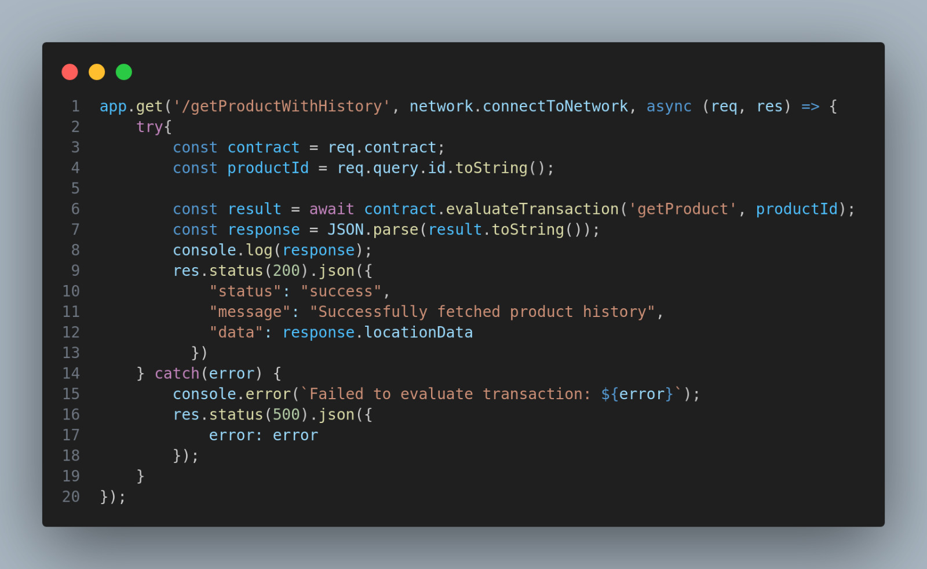
CONT…
GET PRODUCT HISTORY:
Provide the product id and get history of product.
The API code is given in the figure.

Slide 21
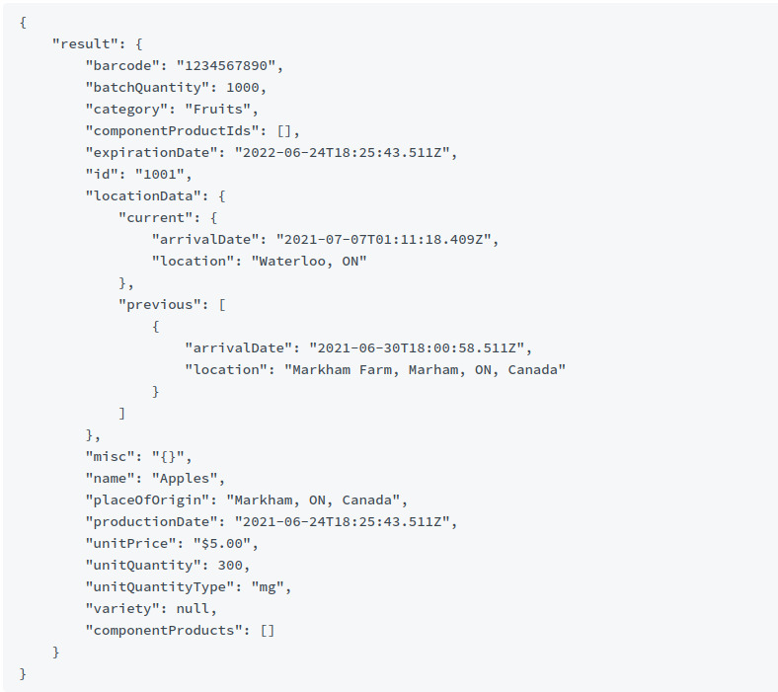
CONT…
Get Product History API:
The output of the above given API snippet is given in the figure.

Slide 22
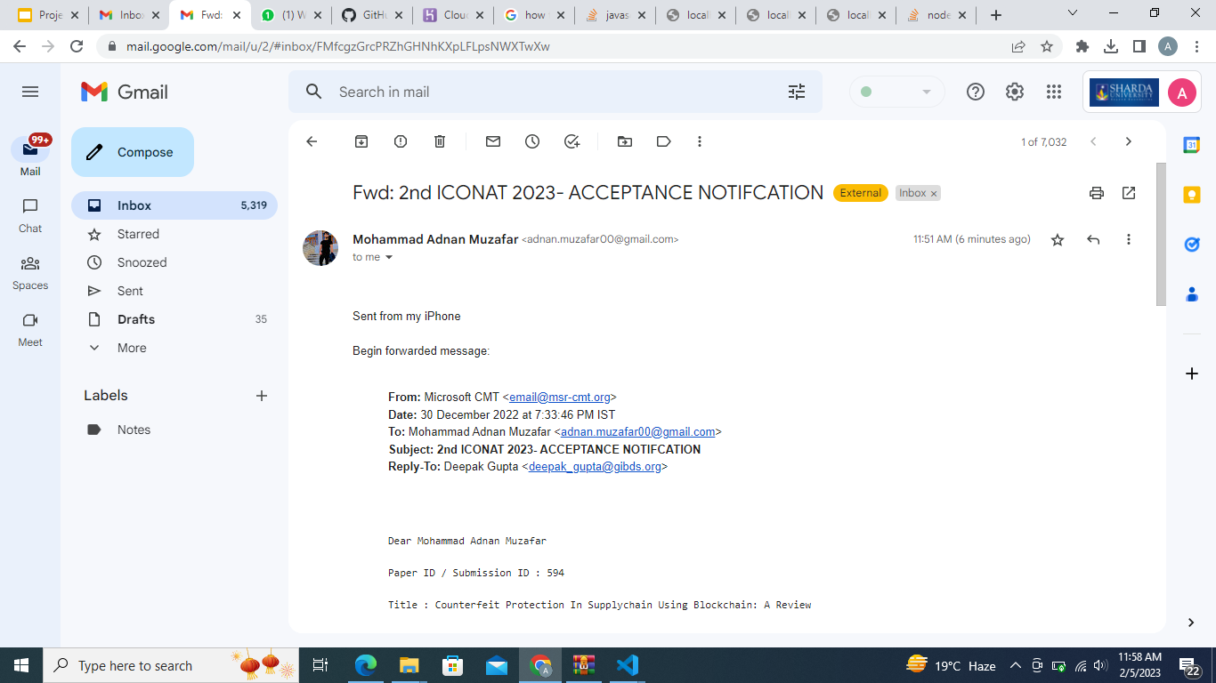
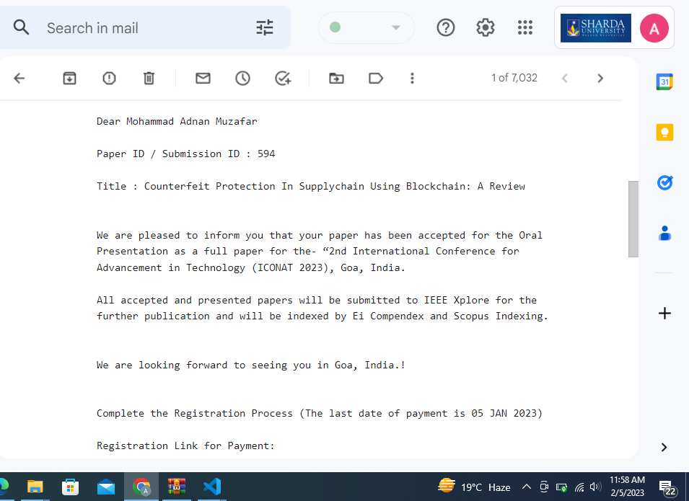
PROOF OF THE OUTCOME OF 7th Semester
The paper has been submitted into the conference, proof of which is given bellow:

Slide 23
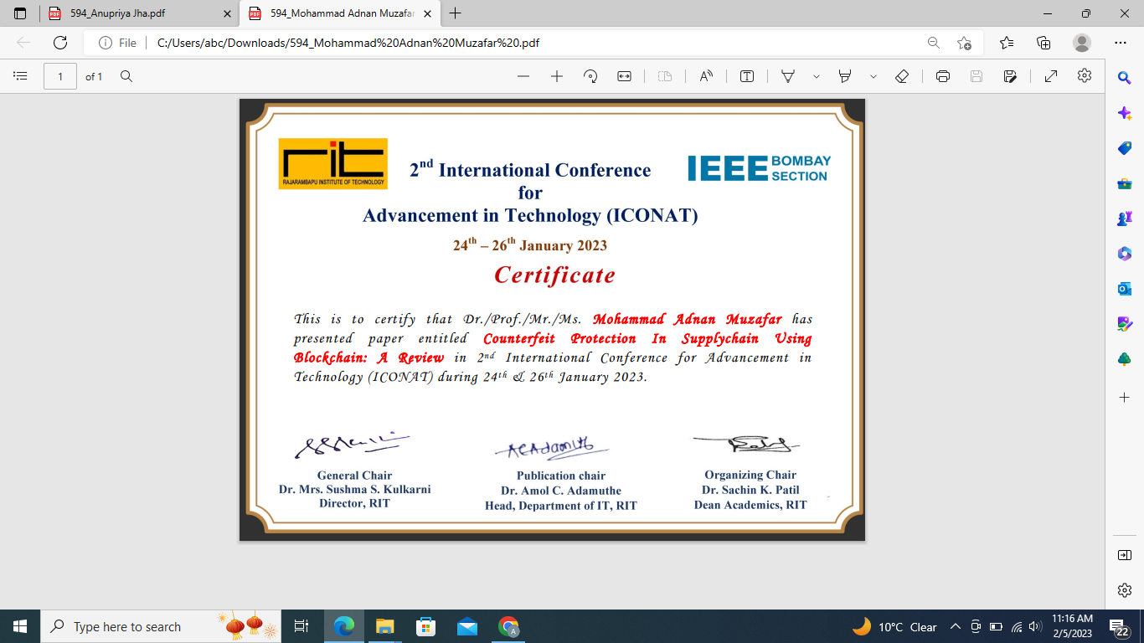
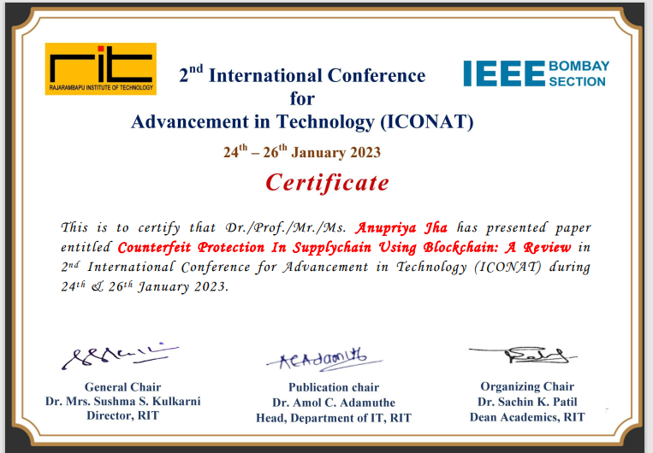
PROOF OF THE OUTCOME OF 7th Semester
Certificate of ICONAT Conference held on 24 to 26 January 2023.
Mohammad Adnan Muzafar
Anupriya Jha

Slide 24
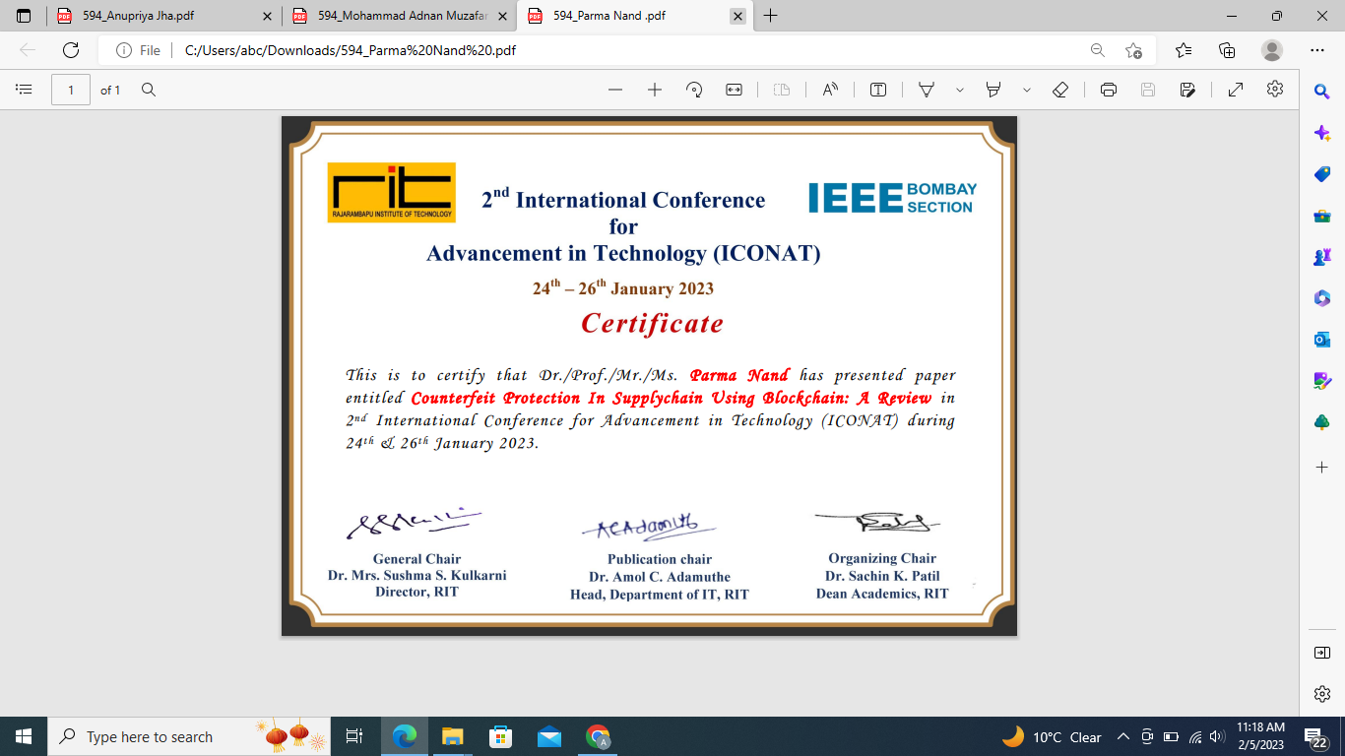
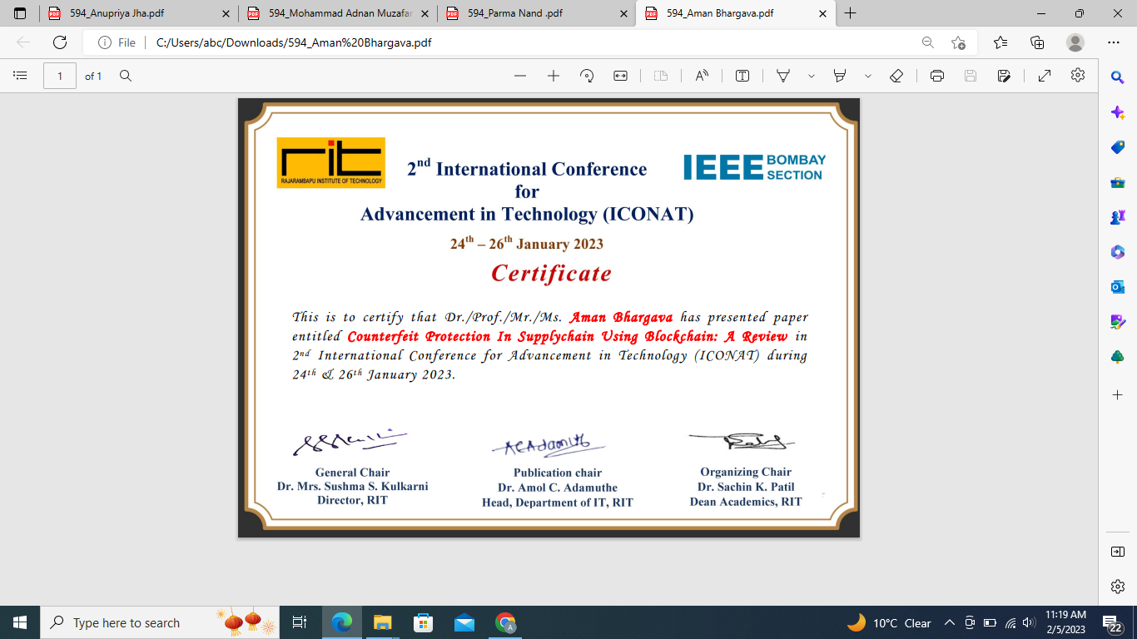
PROOF OF THE OUTCOME OF 7th Semester
Certificate of ICONAT Conference held on 24 to 26 January 2
Dr. (Prof.) Parma Nand Astya (Dean - SET & Academics)
Aman Bhargava

Slide 25
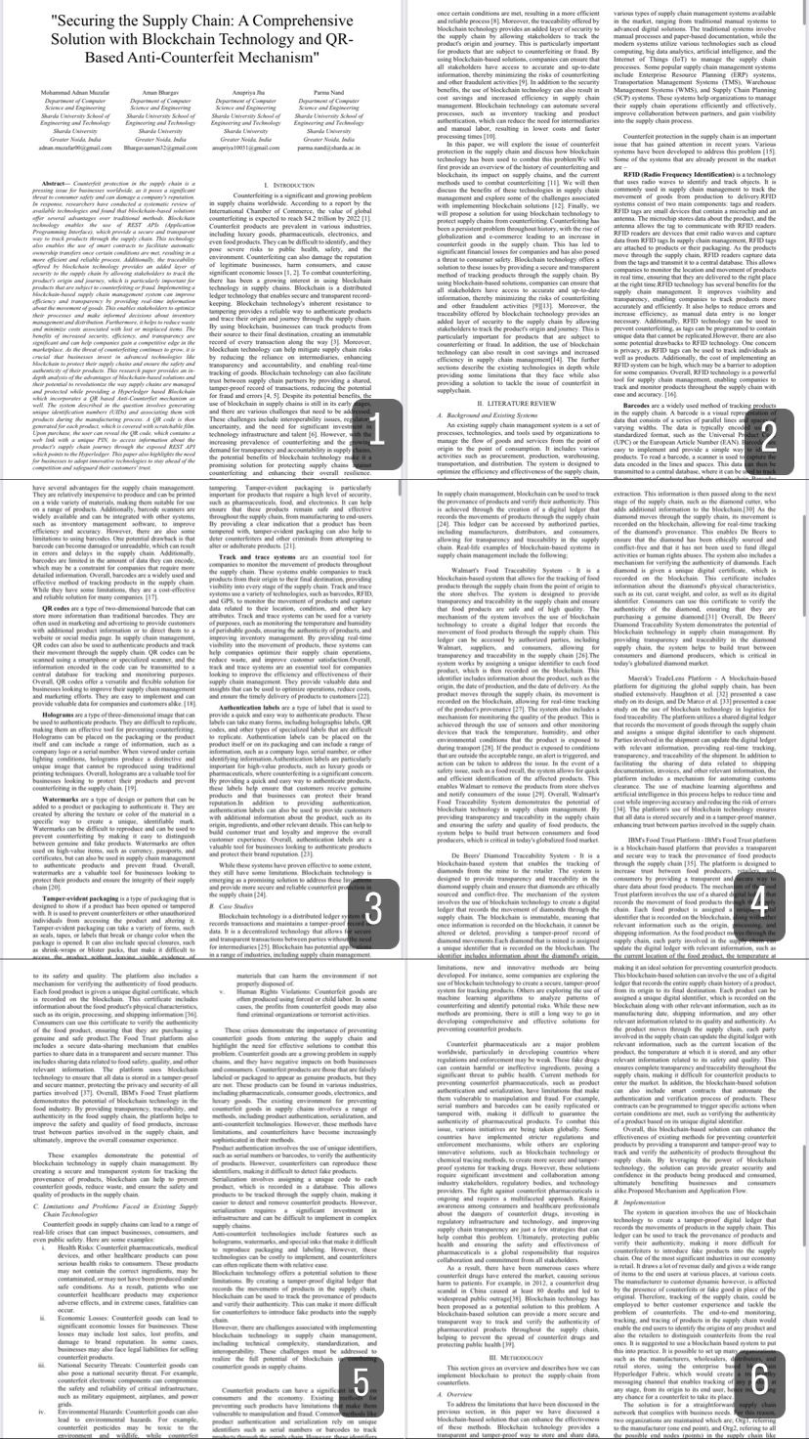
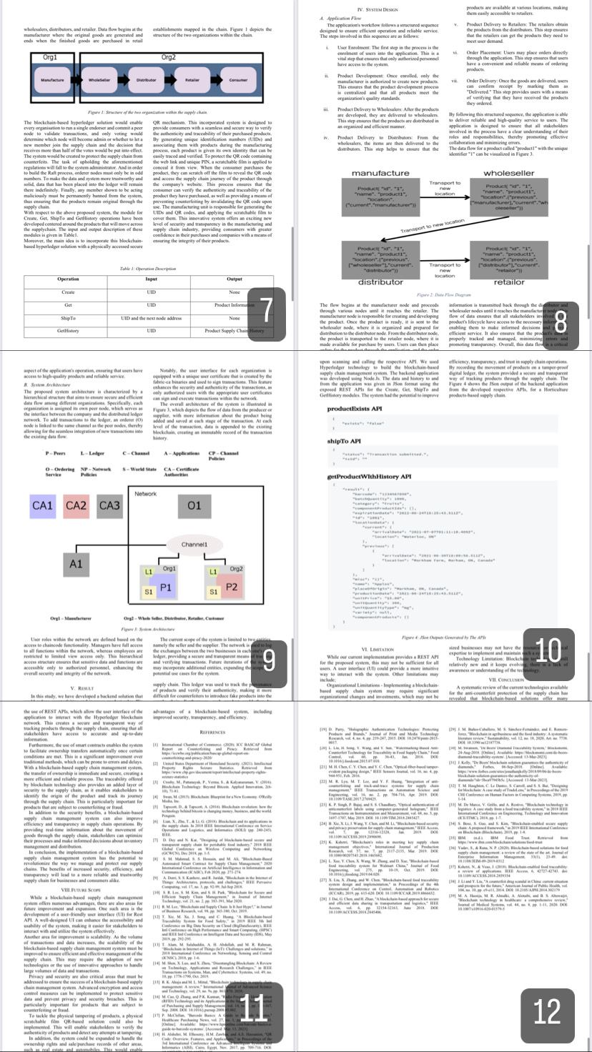
PROOF OF THE OUTCOME OF 8th Semester
We have successfully drafted a Journal research paper and are now working on lowering its plagiarism (current 14%) and enhancing its quality, with taking insights from our Guide, Dr.(Prof.) Parma Nand Astya.

Slide 26
Thank You

